Slide 1


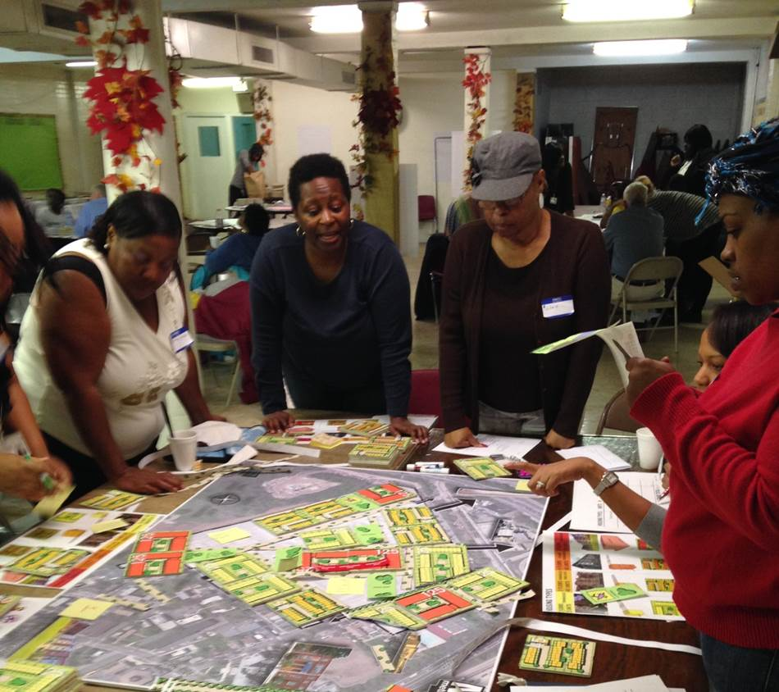
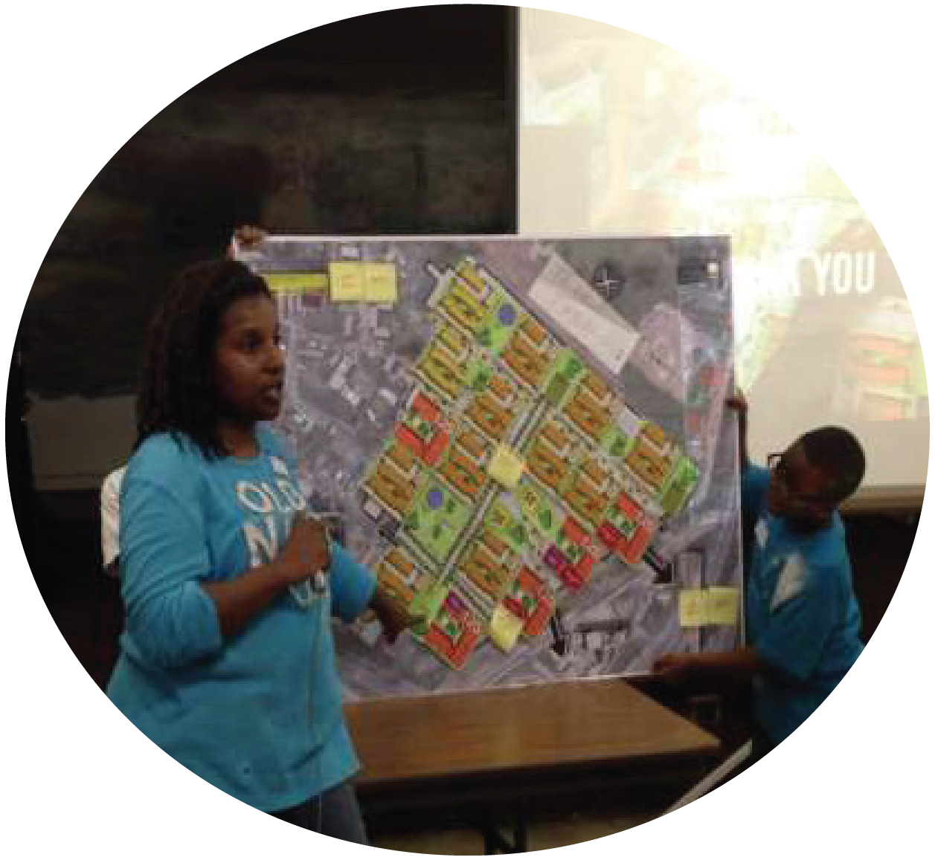





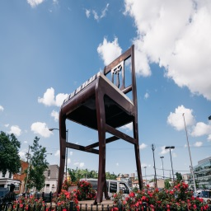
MOVING FORWARD AT BARRY FARM:
A COMMUNITY DIALOGUE|
10.10.18

Slide 2
INTRODUCTIONS – BARRY FARM TEAM
GOVERNMENT PARTNERS
DISTRICT OF COLUMBIA HOUSING AUTHORITY (DCHA) NEW COMMUNITIES INITIATIVE (DMPED)
DEVELOPERS
PRESERVATION OF AFFORDABLE HOUSING (POAH)
A&R DEVELOPMENT
RELOCATION SPECIALIST
HOUSING OPPORTUNITIES UNLIMITED (HOU)
NCI SERVICE PROVIDER
FAR SOUTHEAST FAMILY STRENGTHENING COLLABORATIVE
AND YOU!

Slide 3
COMMUNITY ENGAGEMENT PROCESS
Throughout the community engagement process, we have asked:
How should the
Barry Farm Redevelopment Plan
be refined as a result of the
DC Court of Appeal concerns?

Slide 4
DC COURT OF APPEALS DECISION
Concerns to be addressed:
Consistency with the Small Area Plan (SAP) for Barry Farm:
  Density – SAP calls for up to 1,110 units
  Affordability Mix – SAP calls for 1/3 replacement, 1/3 other affordable and 1/3 market
Amenities - The availability of adequate amenity space for the residents who would lose private yards.
Relocation - A relocation strategy that maintains/strengthens resident connection to the site during the temporary relocation period.
Return - A strategy that accommodates 380 households that are eligible to return
Notes:
4/26/18 The DC Court of Appeals did not say the plan cld not proceed. They vacated the zoning order, and remanded the case back to the DC Zoning Commission to clarify the following five main points about the proposed development plan:
(1) Explain its decision to approve a development characterized by high-density clusters that exceed the density suggested by Policy FSS-2.3.1 of the Comprehensive Plan;
(2) Explain the inconsistency between the Barry Farm Small Area Plan’s suggested unit affordability mix and the Applicant’s proposed distribution;
(3) Address the specific adverse impacts raised by Barry Farm residents and consider the loss of their current amenities as an adverse effect;
(4) Address the adequacy of the relocation plan in order to gauge the overall adverse impact of the proposed PUD; and
(5) Reconcile the dispute between the conclusion that the Applicant will “guarantee that [current residents] can return to the PUD Site after redevelopment if they choose to do so” and that fact that there will be insufficient housing on the PUD site to accommodate all 380 families, should they wish to return.

Slide 5
GIVENS
The process to refine the Barry Farm plan will happen in consultation with residents and other community stakeholders.
Every household who lived at Barry Farm on or after 10/11/12 and is lease compliant will have a right to return as stated in Resolution 16-06. That right lasts until you move into a new unit.
The plan will include units that fit your family size, including large-sized units (i.e. 4, 5 and 6 bedrooms).
There will be a mix of affordable and market-rate units, rental and homeownership.
Relocation and Demolition will continue and Street Improvements will begin in 2019.
Notes:
Every household that lived at Barry Farm on or after October 11, 2012 and is lease compliant per DCHA standards has a right to return to the redeveloped Barry Farm. That right to return lasts until the household moves into a redeveloped unit. So, it does not matter when the household moves, there is still a right to return if that date is met.
Leasing criteria for the new units at Barry Farm that do not set a higher bar for return than what it takes to lease in traditional public housing.
BF plan will include building units that fit the needs of families at the time of their return, which includes large 4-, 5-, and 6-bedroom units for families. DCHA Resolution 16-06 says families have a right to units that fit their household size at the time of return, and we will deliver those units for each returning family.
WE want to bring back a significant number of the replacement units, including large bedroom sizes, in the first phase.

Slide 6
TONIGHT’S OBJECTIVES
IN THIS MEETING WE WILL:
Review how “priorities” identified in previous meetings will be addressed in the Refined Plan
Visit design stations to visualize “priorities”
Gather additional feedback at amenity stations
Review campaign on Resident Connection and Maximizing Return

Slide 7
REFINED MASTER PLAN
KEY CHANGES:
Increased the number of replacement public housing
townhomes
Reduced unit count by removing a floor from the apartment
buildings (except for senior building)
Added courtyards, pocket parks and backyards
Reduced market rate townhomes
Dedicated private space for senior recreation
Added storage space for apartment residents

Slide 8
GREEN SPACE
All residents will have direct access to green space via:
  Courtyards
  Central park
  Linear park
  Pocket parks
  Backyards

Slide 9
AMENITIES
Retail on Sumner Street can accommodate an assortment of
preferred uses
All apartment buildings will contain either a fitness room,
computer center or multi-purpose room
Community service center to be built on site
Feedback today to be gathered on:
  Historical Character
  Rooftops
  Public Spaces
  Courtyards
Notes:
Commty Center to host services like adult literacy programs, job training, or cmmty food pantry

Slide 10
BUILDING ARCHITECTURE
Future apartment floor plans
  Proposed unit square footage is equal or greater
  than existing
Building facades highlight inclusion of some full and
half balconies
Parking garages
Residential storage in garage

Slide 11
OTHER PLAN COMPONENTS
Street improvement to address increased traffic
Apartment buildings will have laundry rooms or in
unit washer/dryer
Historical markers and signage
Utility costs included in rent for replacement public
housing units
Active on-site property management

Slide 12
STAYING CONNECTED DURING RELOCATION
Send residents updated information via direct mail
Continue updating Barry Farm Redevelopment website
(http://barryfarmredevelopment.org/)
Launch Barry Farm Facebook Page
Activate Community Leaders
Continue resident events
  Annual Barry Farm Day & Back to School Drive
  Holiday Parties
  Host NeighborUp Events
Share information at key locations, such as the Barry Farm Rec Center

Slide 13
RESIDENT RETURN CAMPAIGN
Mix of communications style, including standard mail,
robocalls, flyers, Barry Farm redevelopment Facebook page,
TV ads, etc.
No requirements more stringent than public housing
standards
Being current with repayment qualifies as being lease
compliant
Sharing available resources with residents, to help them with
financial literacy

Slide 14
DESIGN STATIONS
Site Plan Changes + Streetscape
Building Architecture + Floorplans
Open Space + Amenity Options

Slide 15
NEXT STEPS
Meeting 5: Monday, October 22nd
Barry Farm Recreation Center

